Slide 1
Final Project Proposal
Group 5
Title: AES-128

Slide 2
Team
Leader : 112061603 李柏叡
Member1 : 112061621 貢暐家
Member2 : 112061576 莊家政

Slide 3
Problem statement
Purpose: AES-128(Advanced Encryption Standard) is a symmetric encryption algorithm that encrypts and decrypts data using a fixed-length key (128 bits).
AES-128 can be used to protect the privacy of sensitive data, ensuring security during transmission and storage.

Slide 4
Project scope
Background Introduction : It can be traced back to 1997 when finding a new advanced encryption standard to replace the then-used Data Encryption Standard (DES). DES was considered insecure due to its 56-bit key length.
What FPGA platform to implement on : KV260
Target Specification : throughput, latency or area

Slide 5
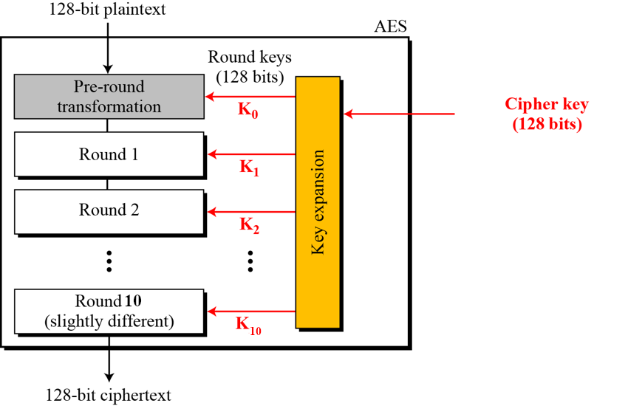
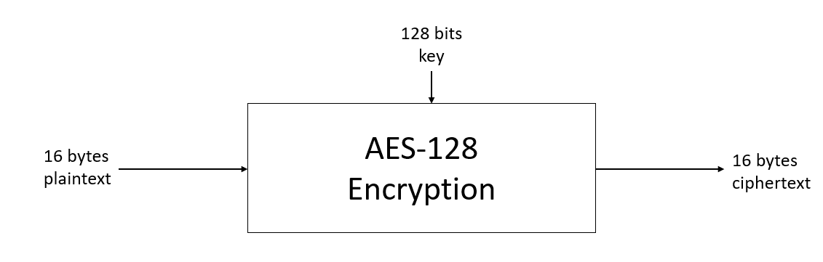
Project scope
System block diagram

Slide 6
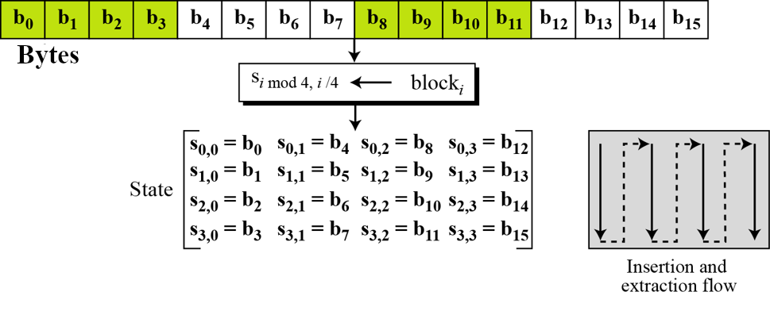
Transform input bytes to state

Slide 7
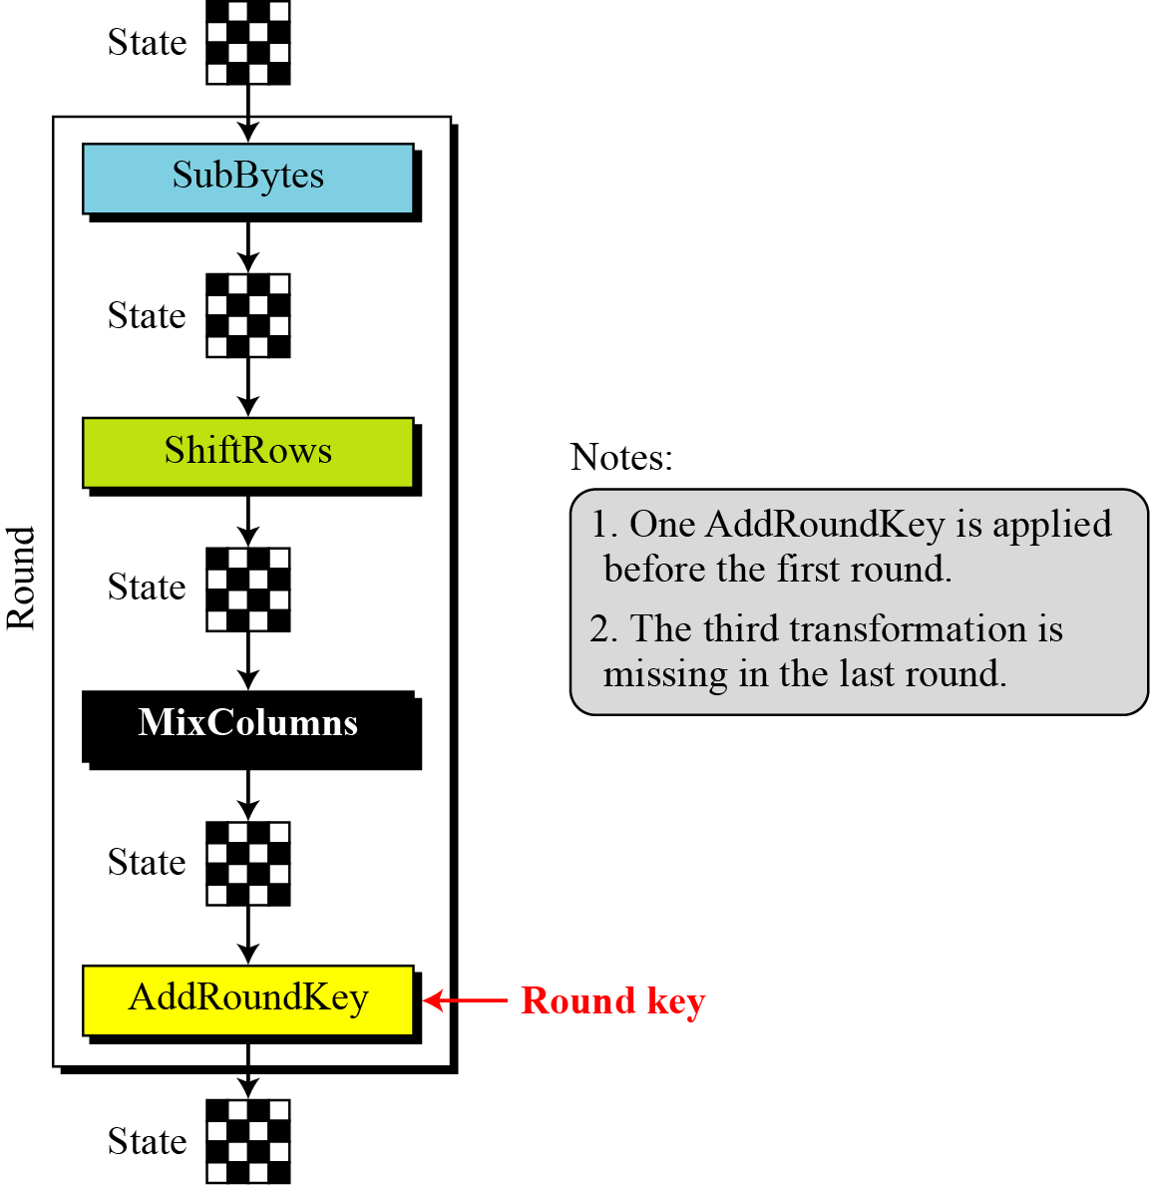
The structure of each round

Slide 8
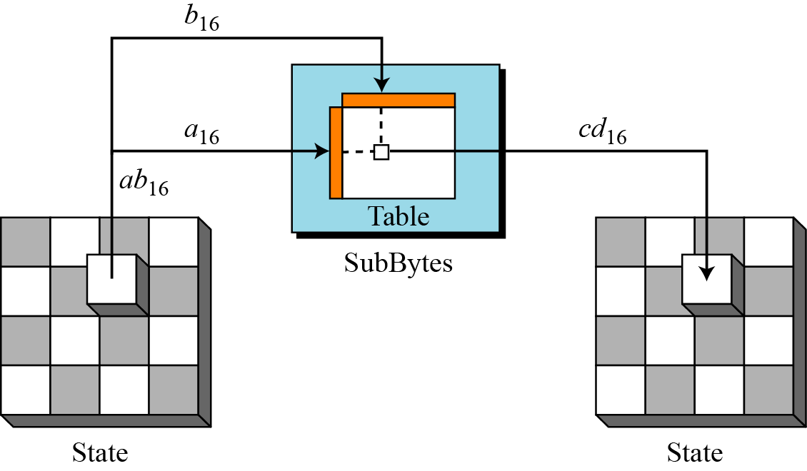
SubBytes
Substitute each bytes according to the lookup table.

Slide 9
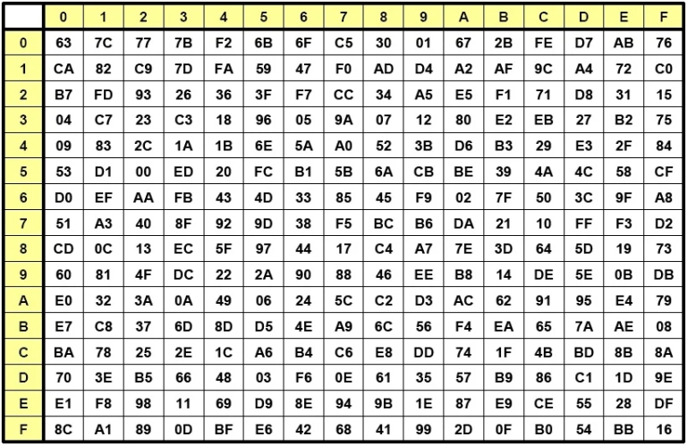
Lookup table for SubBytes

Slide 10
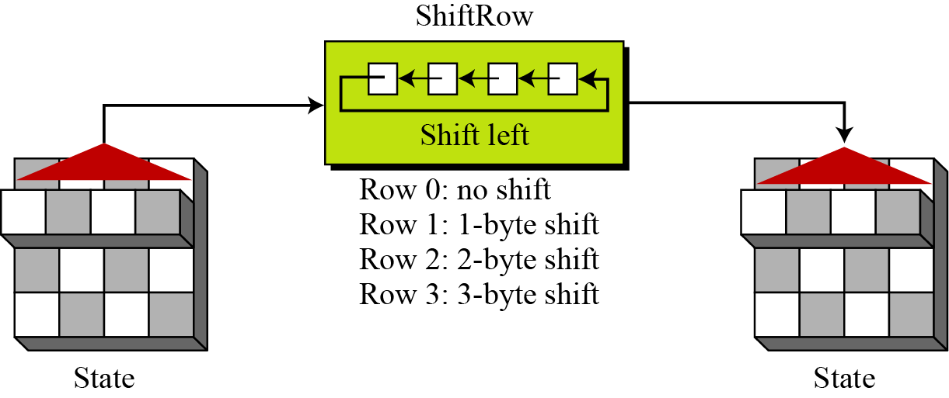
ShiftRows
Shift the bytes in each row cyclically.

Slide 11
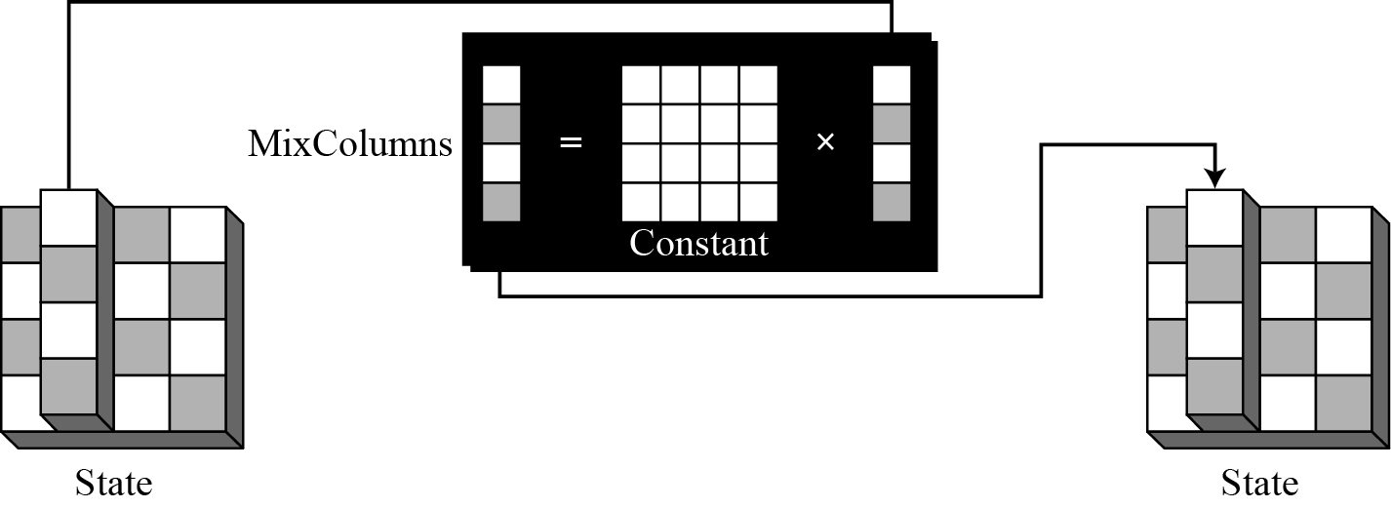
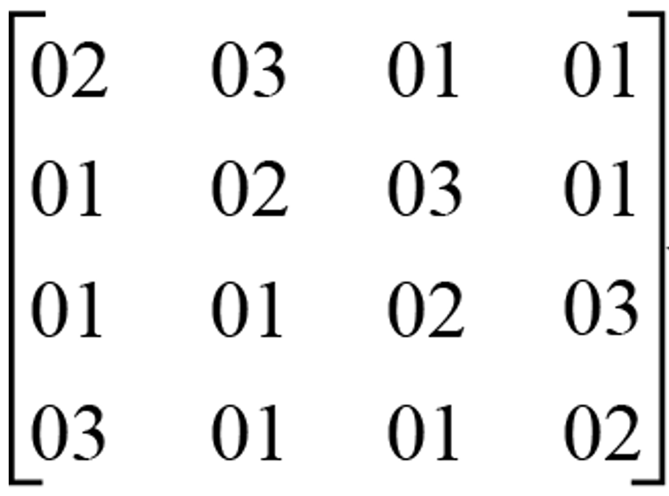
MixColumns
Each column of the state block is mixed using a matrix multiplication operation in GF(2^8).

Slide 12
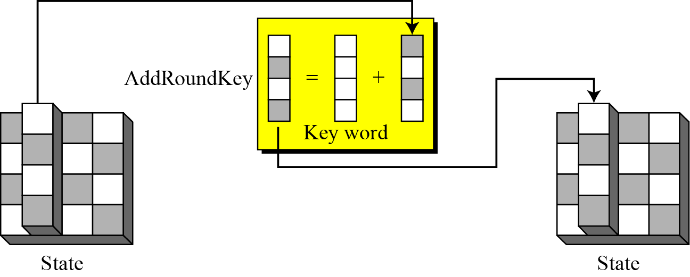
AddRoundKey
The round key for the current round is combined with the state block using bitwise XOR.

Slide 13
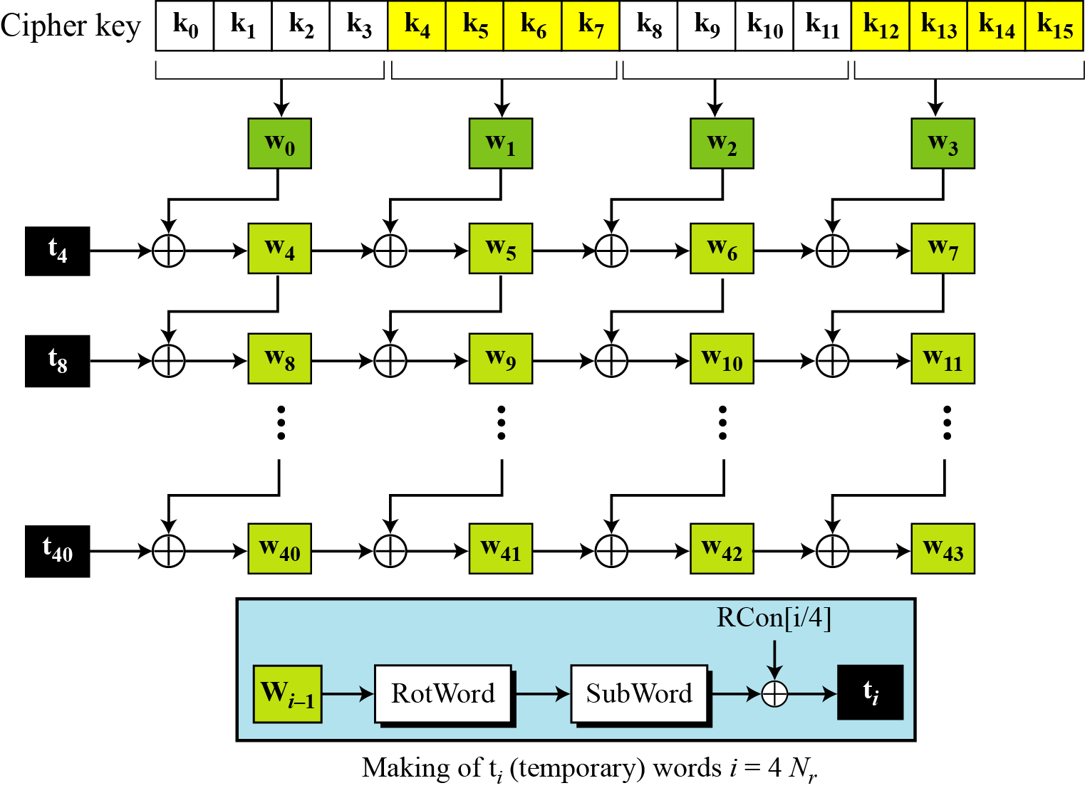
Key Expansion
Round key 0
Round key 1
Round key 2
Round key 10

Slide 14
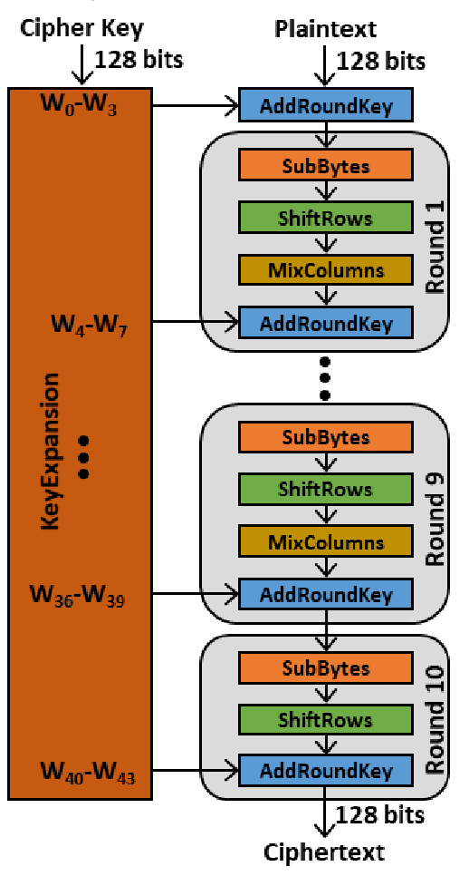
Complete AES-128 Encryption process

Slide 15
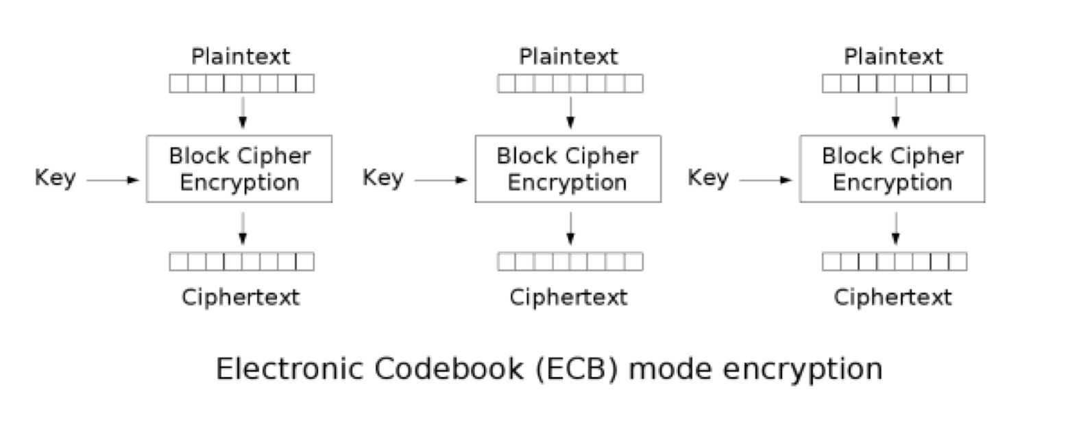
Project scope
Only support AES-128 ECB mode
Operation flow
Program cipher key
Stream in plaintext / Stream out ciphertext

Slide 16
Workflow
•Identify algorithm C-source code - 1-2w
•self-contained, no library function call
•Identify test dataset
•Partition host + kernel
•Run C-sim in Vitis environment Partition - 1-2w
•run through dataset -> check correctness
•Kernel HLS implementation, Host implementation – 2-3w
•define host/kernel communication, including debugging
•If multiple kernels, allow validate separately.
•Host program implement two modes for each kernels (C-code, or FPGA kernel)
•Individual Kernel FPGA validation/integration test - 1w
•Kernel and Host Optimization

Slide 17
Task distribution
112061603 李柏叡 : C code software design 、System integration
112061621 貢暐家 : Key expansion、SubBytes、ShiftRows
112061576 莊家政 : AddRoundKey、MixColumns

Slide 18
Reference
FIPS PUB 197(https://csrc.nist.gov/pubs/fips/197/final)
C++ implementation https://github.com/SergeyBel/AES

